Slide 1
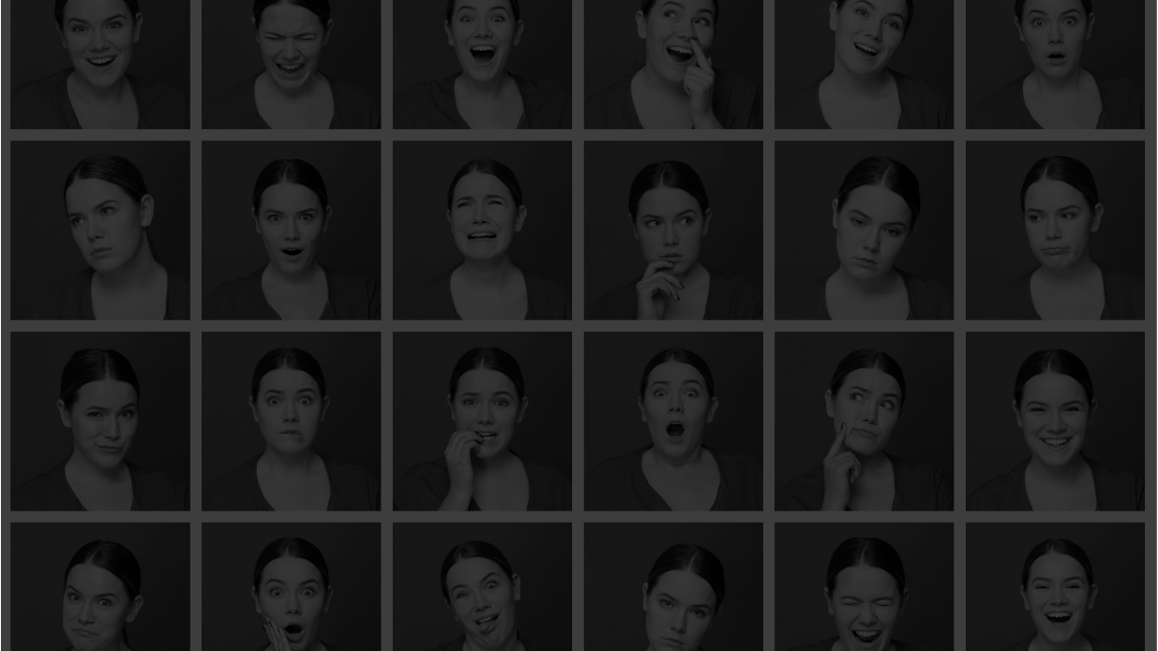
DEEP LEARNING & APPS
FINAL PROJECT
Taeho Lee, Jai Agrawal, Yaohui Wu, Patrick Yip, Jennie Ryu

Slide 2




















Data Overview
Data set
: Face Emotion Images created by gathering the results of a Google image search of each emotion and synonyms​​ of​​ the​​ emotions (FER-2013)
Outcome Variable | # of Images - Total | # of Images - Test | # of Images - Train | # of Images - Validation
angry | 1000 | 200 | 600 | 200
fearful | 1000 | 200 | 600 | 200
happy | 1000 | 200 | 600 | 200
neutral | 1000 | 200 | 600 | 200
sad | 1000 | 200 | 600 | 200
surprised | 1000 | 200 | 600 | 200
Total | 6000 | 1200 (20%) | 1800 (60%) | 1200 (20%)
Outcome Variable : Multi-class
Pre - processing : Normalization

Slide 3

Let’s Play a Game!
Notes:
https://colab.research.google.com/drive/1SjfccS-2oc8rMMjPqMZdrFf8AlPFXEQ9?usp=sharing

Slide 4
Training
Metrics
: Accuracy & Loss
: Model’s goal is to classify each class correctly → no need metrics such as precision or recall
Human-level vs. Model
: Model’s accuracy is fairly good and will increase with more images
Human-level Accuracy : 60% (100 images)
benchmark accuracy : 45%
Logistic Regression
training accuracy : 20%

Slide 5
Training
Improve Training Performance
Bigger Neural Network
Sequential
2 layers (one hidden layer with 64 units, one output layer) : 32.78%
4 layers (64, 32, 32, 6, 3 hidden layers) : 63.94%
CNN
5 layers: 55.5%
6 layers : 75%

Slide 6
Training Improve training Performance
Optimization Algorithm
Sequential |  |  | CNN
Adam | SGD | Adamax | Adam | SGD | Adamax
63.9% | 50.89% | 76.4% | 75% | 24% | 84%
Iterations (epochs)
Sequential |  |  | CNN
Epochs = 100 | Epochs = 300 | Epochs = 500 | Epochs = 10 | Epochs = 25 | Epochs = 50
55.39% | 76.3% | 99.17% | 84% | 64% | 99.94%

Slide 7
Training Improve training Performance
Weight Initialization
kernel_initializer='random_uniform', bias_initializer='zeros'
kernel_initializer='he_uniform', bias_initializer='ones'
kernel_initializer=tf.keras.initializers.RandomUniform(minval=-0.05, maxval=0.05), bias_initializer=tf.keras.initializers.Constant(value=0.4)
Sequential |  |  | CNN
1 | 2 | 3 | 1 | 2 | 3
89% | 99.36% | 96.53% | 99.81% | 99.92% | 99.97%

Slide 8
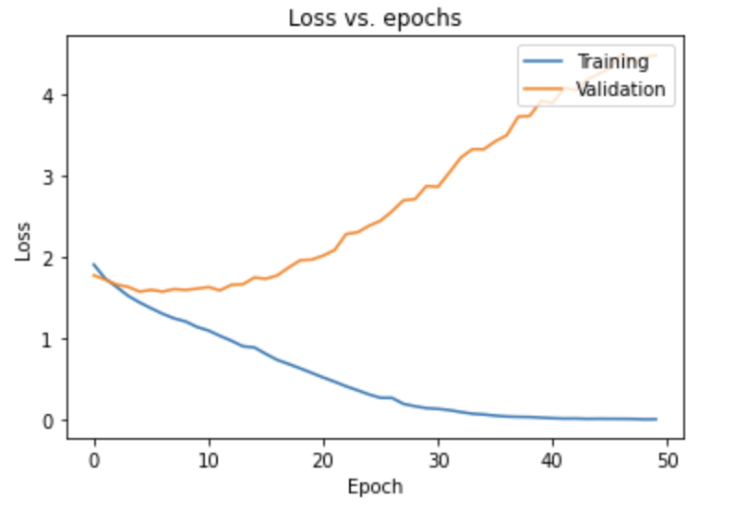
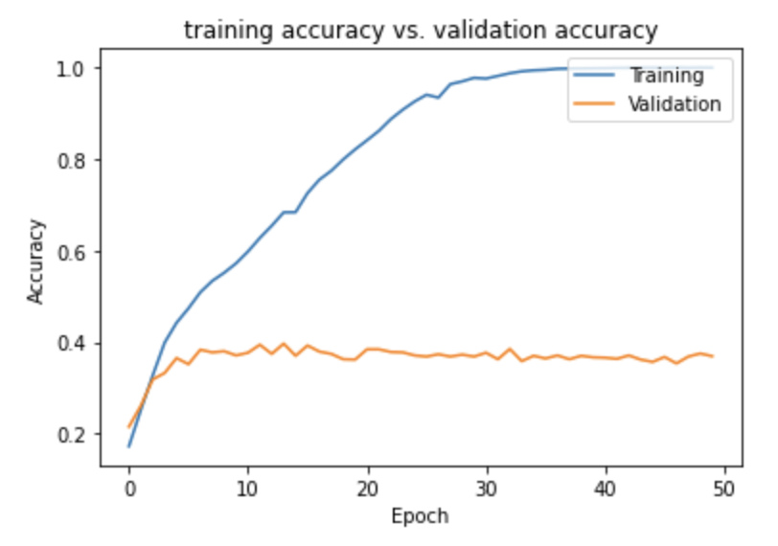
Training Best Model
CNN
Model fit result with Optimizer : Adamax and epochs = 50, weight initialization 3, 6 layers

Slide 9
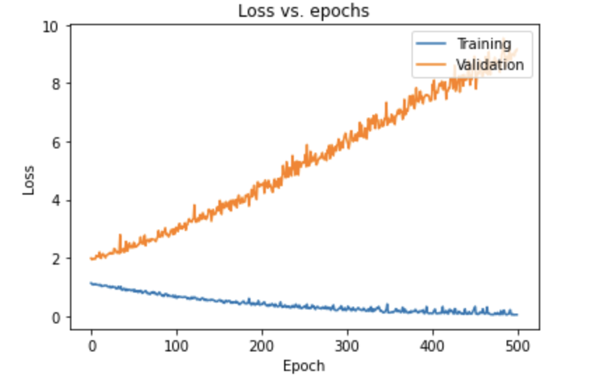
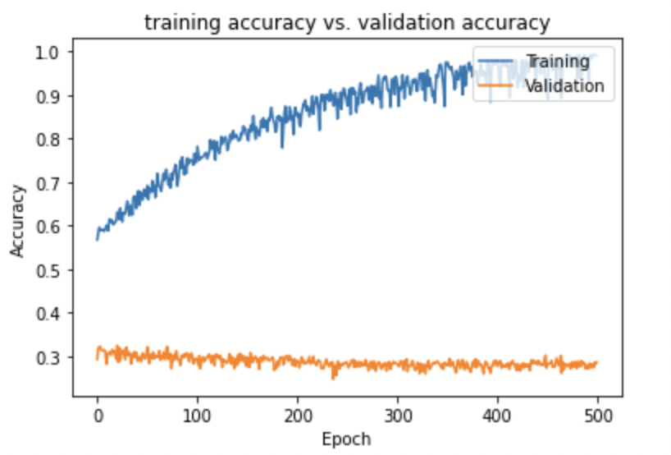
Training Best Model
Sequential
Model fit result with optimizer : Adamax and epochs = 500
Best model: epochs = 500, optimizer = Adamax, 4 layers

Slide 10
Validation
Training : 99.94%
Validation : 37.50%
How well our model fit the validation data compared to training performance?
→ Difference between training and validation is 62.44%
(overfitting)
Notes:
As you can see in the previous slide, our model has the overfitting problem. The difference between training and validation set is about 62%, so we need to reduce it.

Slide 11
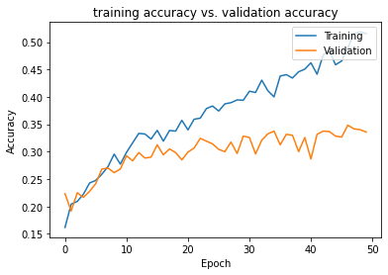
Validation
Improve Validation Performance
L2 Regularization
lambda | 0.0001 | 0.0005 | 0.001 | 0.005 | 0.01
Training | 97.17% | 96.97% | 94.69% | 43.06% | 37.25%
Validation | 36.83% | 36.25% | 37.42% | 32.08% | 30.25%
diff. | 60.34% | 60.72% | 57.26% | 10.98% | 0.70%
Notes:
To improve validation performance, first we apply L2 Regularization to our model, and we can see that the difference decreased as the lambda value. However, if the lambda is too big, accuracy goes down, so we can conclude that between 0.001 and 0.005 is the appropriate range of the lambda.

Slide 12
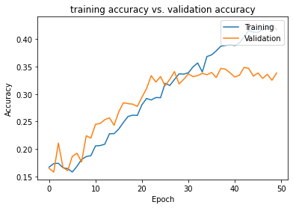
Validation Improve Validation Performance
Dropout Regularization
Drop Rate | 0.1 | 0.3 | 0.5 | 0.7 | 0.9
Training | 94.03% | 93.83% | 69.42% | 41.61% | 16.94%
Validation | 36.58% | 36.92% | 37.42% | 33.83% | 16.67%
diff. | 57.45% | 56.81% | 32.00% | 7.78% | 0.27%
Notes:
Second we apply dropout Regularization to our model, and we can see that the difference also decreased as the dropout rate increased. However, if the dropout rate is too large, accuracy goes too low, so we can conclude that between 0.5 and 0.7 is the appropriate range of the dropout rate.

Slide 13
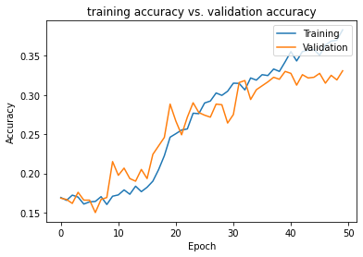
Validation Improve Validation Performance
Mixture of L2 and Dropout Regularization
lambda | 0.002 | 0.002 | 0.003 | 0.003 | 0.0005
Drop rate | 0.5 | 0.7 | 0.5 | 0.7 | 0.7
Training | 39.97% | 30.33% | 37.08% | 29.78% | 38.31%
Validation | 32.58% | 30.00% | 31.25% | 30.33% | 33.08%
diff. | 7.39% | 0.33% | 5.38% | -0.55% | 5.23%
Notes:
By using the mixture of L2 and dropout, we can decrease the difference to 5% but accuracy little goes down compared to the original validation accuracy. Next, Jennie will explain batch normalization.

Slide 14
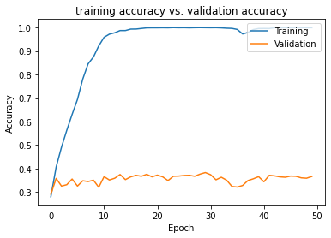
Validation Improve Validation Performance
Batch Normalization
momentum | Default | 0.95 | 0.9 | 0.95 | 0.95
epsilon |  | 0.005 | 0.0005 | 0.0005 | 0.0005
gamma |  | 0.9 | 0.9 | 0.9 | 0.5
Training | 99.94% | 99.89% | 99.61% | 99.94% | 99.92%
Validation | 36.67% | 35.83% | 27.08% | 35.83% | 36.67%
diff. | 63.27% | 64.06% | 72.53% | 64.11% | 63.25%
Notes:
Next, we apply batch normalization to our model, but it is not as powerful as L2 or dropout regularization method.
But We found that decrease epsilon and gamma can reduce the difference between training and validation accuracy.

Slide 15
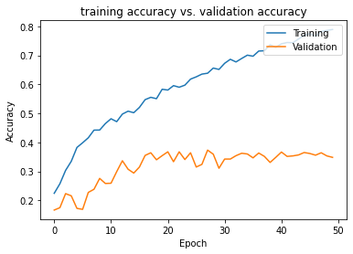
Validation Improve Validation Performance
Mixture of Dropout Regularization and Batch Normalization
Drop rate | 0.5 | 0.5 | 0.5 | 0.7 | 0.7
momentum | 0.95 | 0.95 | 0.95 | 0.95 | 0.95
epsilon | 0.0005 | 0.0001 | 0.0001 | 0.005 | 0.0005
gamma | 0.5 | 0.5 | 0.9 | 0.9 | 0.5
Training | 97.94% | 92.33% | 94.94% | 85.19% | 78.92%
Validation | 36.67% | 37.25% | 34.33% | 36.75% | 34.83%
diff. | 61.27% | 55.08% | 60.61% | 48.44% | 44.09%
Notes:
By using the mixture of dropout regularization and batch normalization, It was possible to reduce the difference compared to using batch normalization alone, but not so much.

Slide 16
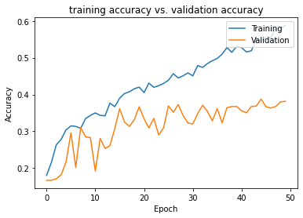
Validation Improve Validation Performance
Mixture of L2, Dropout Regularization and Batch Normalization
lambda | 0.0005 | 0.001 | 0.003 | 0.003 | 0.005
Drop rate | 0.5 | 0.5 | 0.3 | 0.3 | 0.4
momentum | 0.95 | 0.95 | 0.95 | 0.95 | 0.95
epsilon | 0.0005 | 0.0005 | 0.0005 | 0.0001 | 0.0005
gamma | 0.9 | 0.5 | 0.9 | 0.9 | 0.5
Training | 71.83% | 64.86% | 82.61% | 17.44% | 58.83%
Validation | 37.92% | 36.42% | 35.67% | 16.67% | 38.17%
diff. | 33.91% | 28.44% | 46.94% | 0.77% | 20.66%
Early Stopping cannot improve validation performance
Notes:
Finally, when we use all three methods together, we can get the best result. The validation accuracy is 38% and the difference between training and validation is about 20%.

Slide 17
Best Model
CNN Model with Mixture of L2, Dropout Regularization and Batch Normalization
Layers | 6
Optimization Algorithm | Adamax
Epochs | 50
Weight Initialization | Bias (0.4)
lambda | 0.005
Dropout rate | 0.4
Batch Normalization Parameters | momentum=0.95 epsilon=0.0005 gamma=0.5
Training | 58.83%
Validation | 38.17%
Test | 39.83%

Slide 18


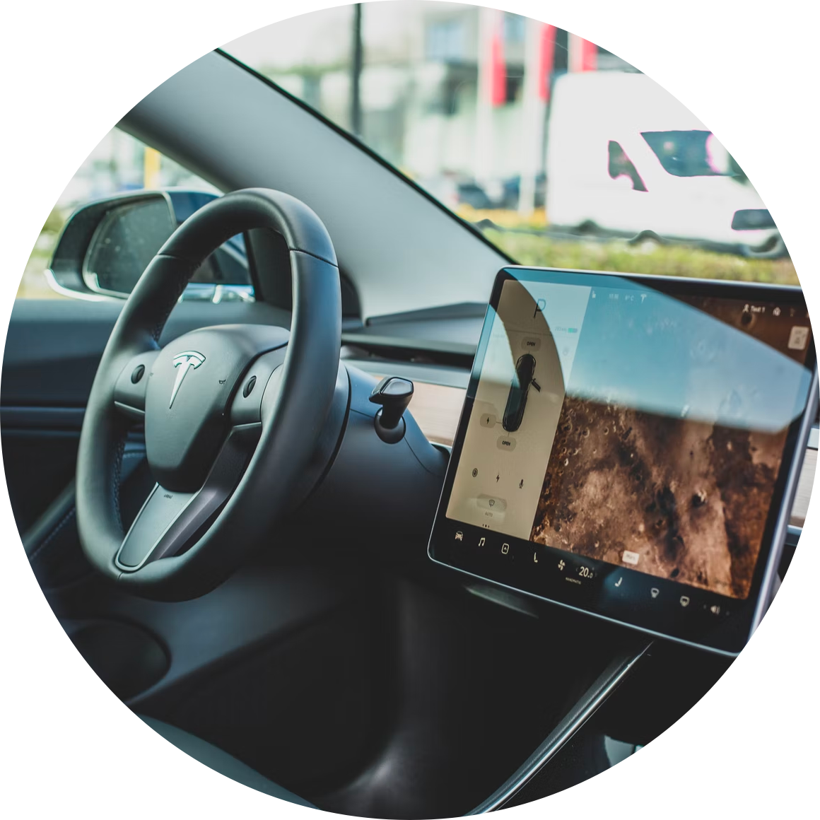
Business Implications
Market Research
Healthcare
Auto Manufacturers
Check customer’s facial reaction
→ understand reaction to a product
Examine footage in emergency room
→ determine patient’s condition
Incorporate more facial features
→ alert driver and prevent accidents
Notes:
https://sightcorp.com/blog/3-ways-companies-are-using-emotion-detection-technology/
https://www.itbusinessedge.com/business-intelligence/value-emotion-recognition-technology/
Market research - checking customer facial reactions to understand how they reacted to a product
Healthcare - examining footage in a waiting room t the emergency room to determine how people are feeling
Auto Manufacturers - slowly getting more technically advanced - could incorporate more facial features to alert a driver falling asleep or roid rage.

Slide 19
THANK YOU
Notes:
https://sightcorp.com/blog/3-ways-companies-are-using-emotion-detection-technology/
https://www.itbusinessedge.com/business-intelligence/value-emotion-recognition-technology/
Market research - checking customer facial reactions to understand how they reacted to a product
Healthcare - examining footage in a waiting room t the emergency room to determine how people are feeling
Auto Manufacturers - slowly getting more technically advanced - could incorporate more facial features to alert a driver falling asleep or roid rage.

